Slide 1

Predicting energy levels
Team 1
Anika Bhati, Joanne Charles, Eason Ho, Kimmy Liu, Sungwoo Noh, Gavin Park

Slide 2

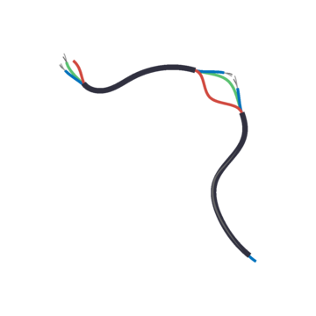
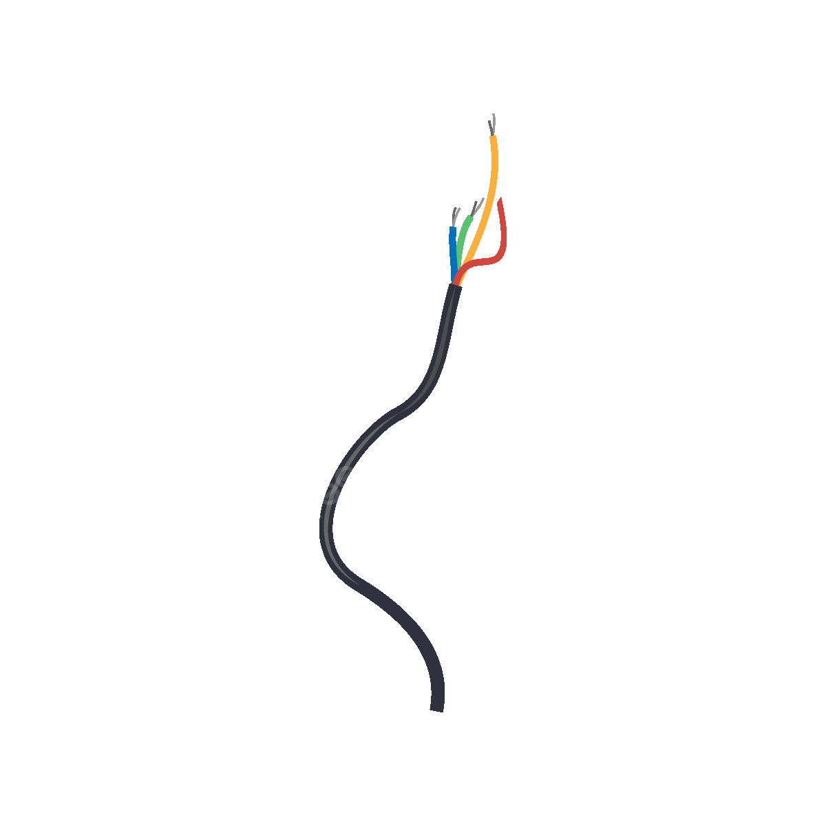
Table of contents
02
03
01
06
05
04
Linear Regression, Lasso and Ridge
KNN
Introduction
& EDA
Conclusion
Comparing models
Trees

Slide 3

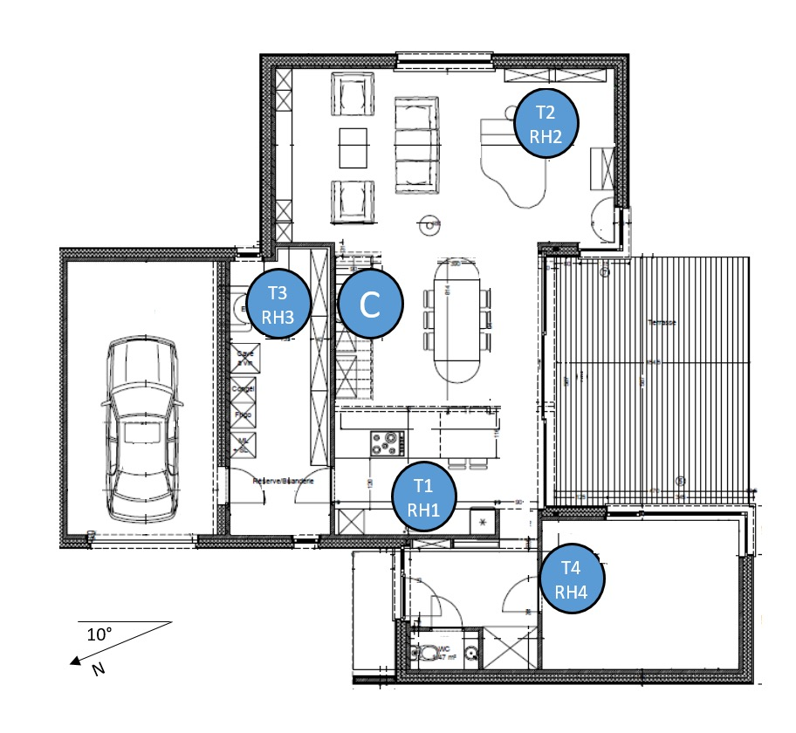
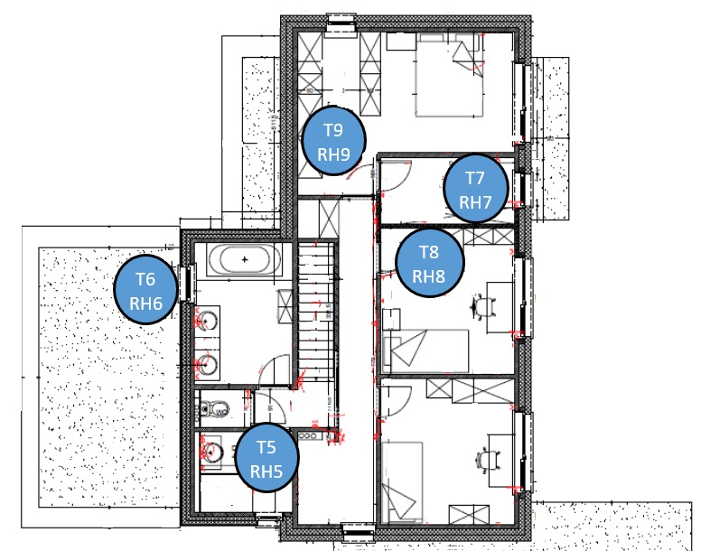
Introduction
First floor plan
Data Sources: UC Irvine Machine Learning Repository
Problem: accurately predicting the energy consumption of appliances in a low-energy building.
The aim is to understand how internal environmental conditions (e.g., room temperature, humidity) and external weather conditions affect energy use (In Watts)
Each observation is recorded every 10 minutes for 4.5 months. The internal temperature and humidity were recorded using a ZigBee wireless sensor network
Second floor plan
Instances
19735
Features
28
Missing Values
0
All variables are numeric and continuous
Notes:
To be included (just write the results, no need to organize or make it look aesthetic)feel free to add a slide for this section, if needed
Data source- describe the data - link
objective -what we’re solving- take from propsal slide
And why this matters- proposal slide
Done in the slides below

Slide 4
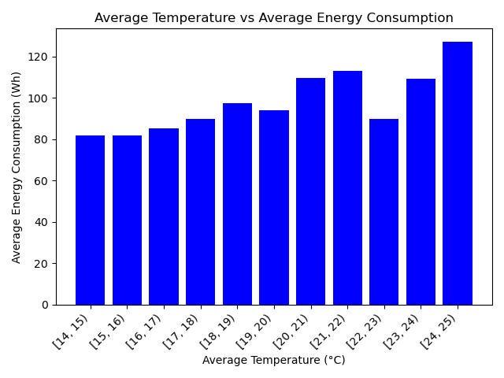

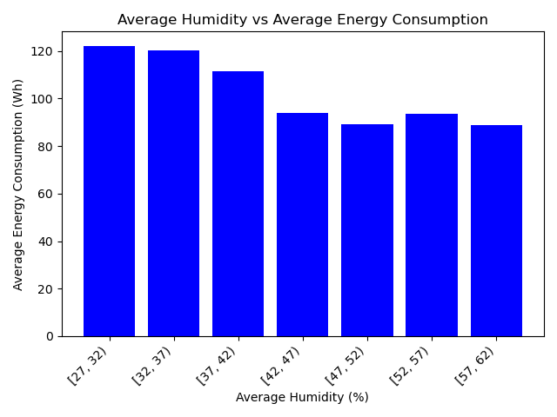
EDA 1
Outcome variable: Appliances_log
Predictors
Energy use of lights fixtures measured in Wh (lights)
Temperature in celsius and Humidity in % of different rooms such as kitchen, bathroom, living room, etc (T1, T2, T3….., T9)
Humidity in % in different (RH1, RH2, RH3…….RH9)
Wind speed measured in m/s
Visibility in km
Dew point in celsius
Baseline Model (ŷ)
Tr MSE: 0.418
Te MSE: 0.453
Notes:
Our outcome variable is the amount of energy used by appliances in a low-energy environment

Slide 5

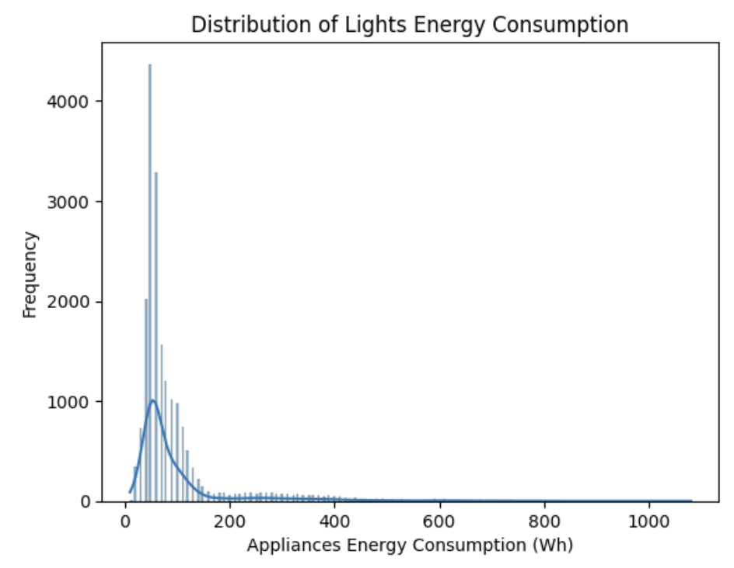
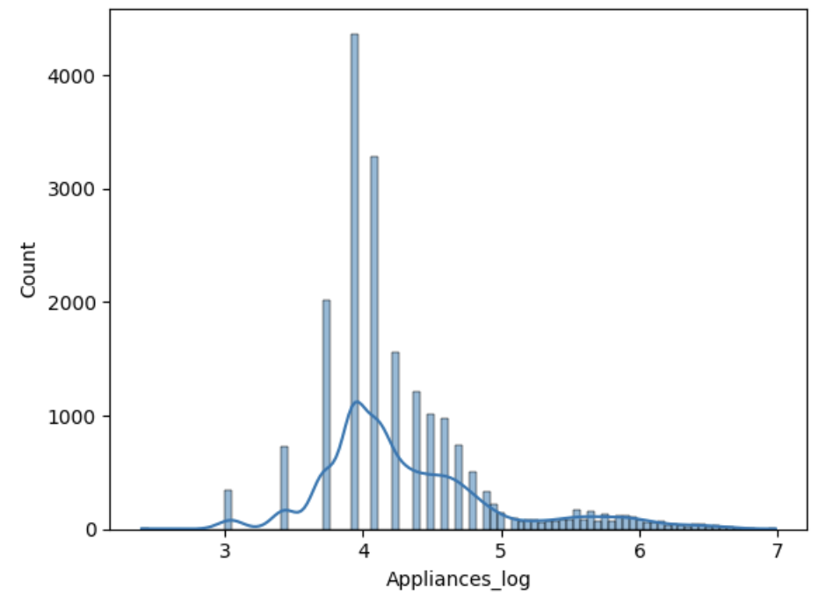
EDA 2
Adding a new variable
def assign_season(month):
if month in [12, 1, 2]:
return 'Winter'
elif month in [3, 4, 5]:
return 'Spring'
elif month in [6, 7, 8]:
return 'Summer'
else:
return 'Fall'
# Apply the function to create a new 'season' column
df['season'] = df['date'].dt.month.apply(assign_season)
Log distribution= replicates a normal distribution
Season distribution
Fall
0
Summer
0
Winter
7098
Spring
12637
Data split
Train
13814
Validation
2960
Test
2961
Notes:
Share some important/ informative visuals
Talk about variation in data
Log transformation
Adding an extra var: season
How did u divide the data: test/train/val

Slide 6

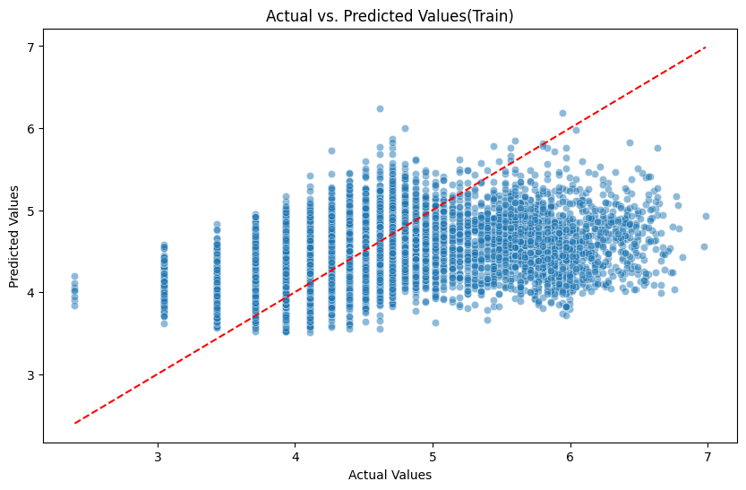
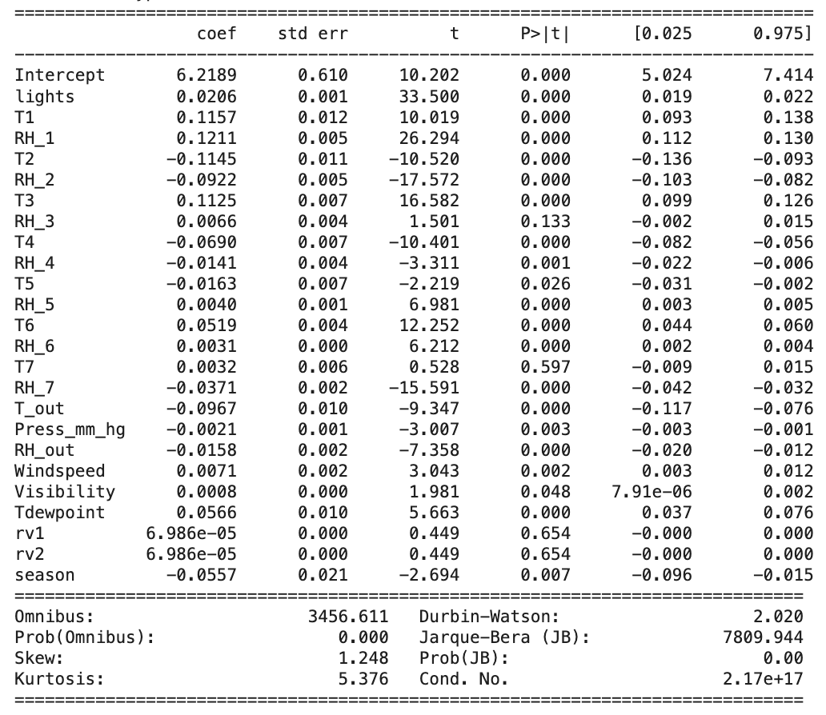
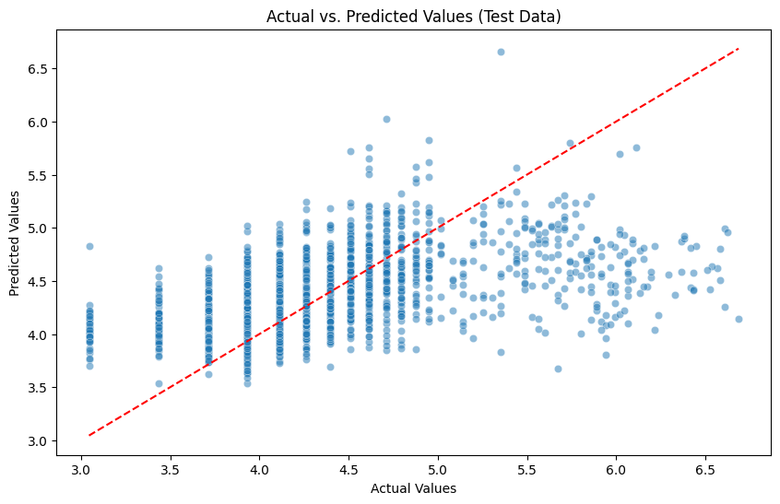
Linear Regression
Tr MSE: 0.31
Te MSE: 0.33
Possibility of overfitting, not the best model for our data
Tr R²: 0.2710
Te R²: 0.2718
Notes:
Joanne
From OLS, some important variables are the temp in kitchen area, temp in laundry area, and humidity in kitchen area
Because we had so may variables, it was expected that lr wouldnt’ capture all of them in a straight
To be included (just write the results, no need to organize or make it look aesthetic) . feel free to add a slide for this section, if needed
Walk thru the process specific to project
Share visual of LR
Anything interesting?
MSE train and test

Slide 7
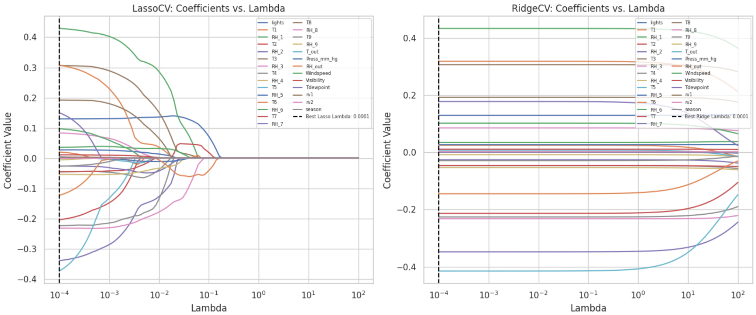
Lasso vs. Ridge
Optimal lambda (0.0001). Key predictors like T2 and Lights remain strong contributors, while less relevant coefficients (e.g. Visibility) are eliminated.
Optimal Lambda (0.0001 balances all feature contributions, retaining predictors like RH_out and T_out as key drivers of performance.
Notes:
These graphs illustrate the coefficient-shrinking characteristics of lasso and ridge regression. Lasso shrinks some coefficients to zero, while ridge reduces them close to zero. However, he black vertical dashed line, which indicates that the optimal lambda, for both models is near zero, which means that in this case both models aren’t really penalizing large coefficients. And since both lambdas are basically the same, so as we will see later, they have identical results. In addition, since the optimal lambda is nearly zero, the results for these two models will also be very close to ordinary least squares regression as we will see later

Slide 8
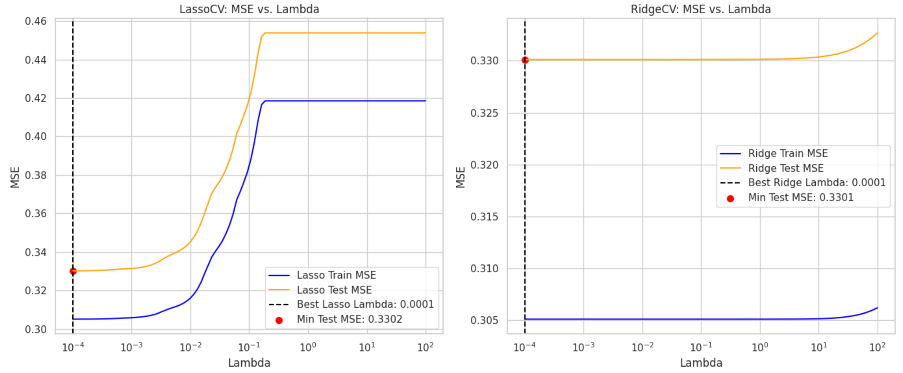
Lasso vs. Ridge
At the optimal lambda (0.0001), Lasso achieves the lowest Test MSE of 0.330. Beyond this, Lasso starts penalizing coefficients like RH_out_log and T9 to zero, leading to an increase in Test MSE as important features are removed.
With the optimal lambda (0.0001), Ridge achieves a Test MSE of 0.330 while retaining all coefficients. As lambda increases, all coefficients shrink proportionally, and Test MSE stabilizes before slightly increasing.
Notes:
The lasso graph shows that both test and train MSE increase rapidly with the initial rise in lambda before plateauing. In contrast, the ridge graph indicates only a minimal increase in MSE beyond the optimal lambda. For both models, test MSE is larger than train MSE, which aligns with theory.

Slide 9
Feature Importance
Lasso | Ridge
Key Features T2 (Coefficient: 0.45): A strong predictor for the target, potentially linked to a significant relationship with energy consumption. RH_1 (Coefficient: -0.12): Suggests that a decrease in RH_1 values corresponds to a slight increase in the target variable. Lights (Coefficient: 0.34): Indicates that lighting has a moderate impact on the target. | Key Features: RH_out (Coefficient: 0.85): The strongest predictor in the model, indicating a high correlation with the target variable. T_out (Coefficient: -0.42): Highlights an inverse relationship, where lower T_out values predict a higher target. Lights (Coefficient: 0.34): Retained as moderately significant for the predictions.
Excluded features T9, Visibility, RH_out_log: These features were assigned a coefficient of 0, meaning they were deemed irrelevant for predicting the target variable. | All features retained Unlike Lasso, Ridge does not exclude any features. Instead, it shrinks coefficients proportionally to reduce their influence without eliminating them.
Improves interpretability, especially when dealing with datasets with many irrelevant features. | Useful for datasets where multicollinearity (high correlation among predictors) is a concern.
Tr MSE: 0.305
Te MSE: 0.330
Tr MSE: 0.305
Te MSE: 0.330
Tr R²: 0.271
Te R²: 0.271
Tr R²: 0.271
Te R²: 0.272

Slide 10
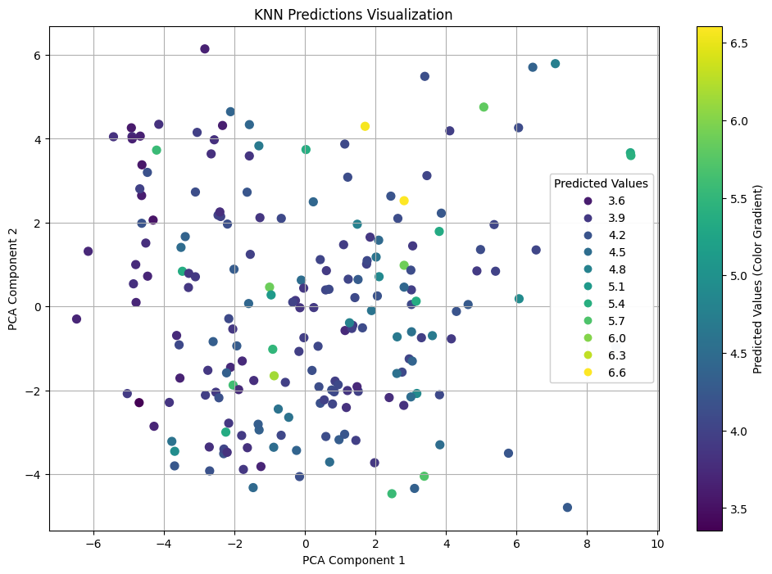
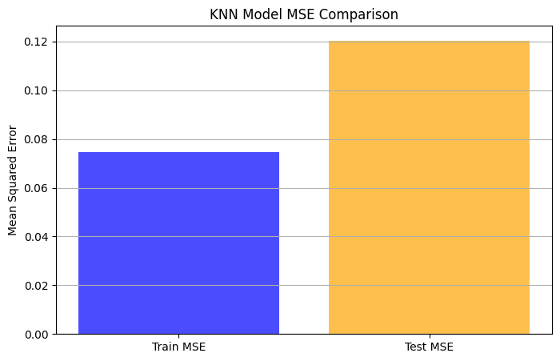
KNN
Step 1: Data preprocessing:
The dataset was split into training and test sets.
Features were normalized (standard scaler) to ensure fair distance calculations in KNN.
Step 2: Model training:
The K-Nearest Neighbors (KNN) model was trained on the training data using different values of k.
Step 3: Selection of optimal k:
5!!!
KNN Results
Tr MSE: 0.32819284736592847
Te MSE: 0.36487102375918239
Tr R²: 0.28917265398127465
Te R²: 0.23158476923851693

Slide 11
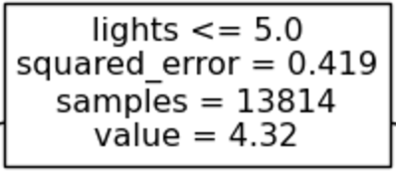
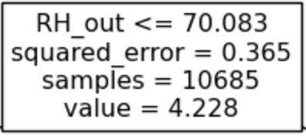
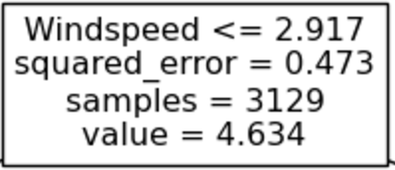
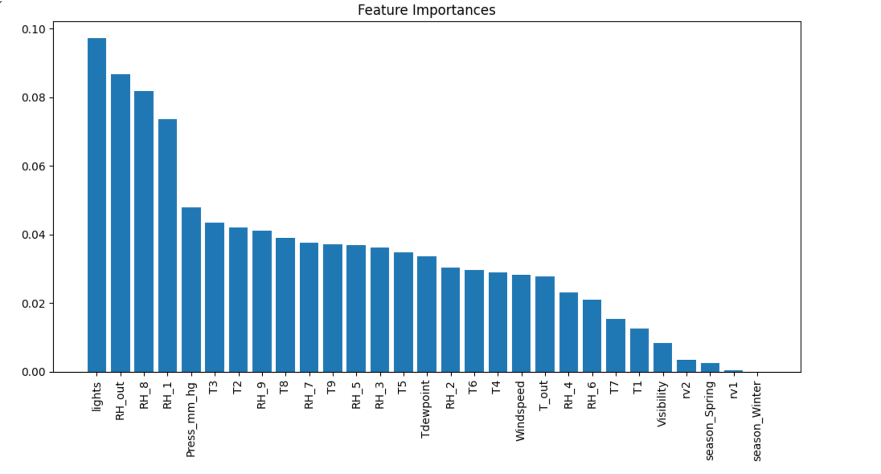
Decision Tree
Decision Tree Results
Tr MSE: 2.41701e-32
Te MSE: 0.27122
True
False
Tr R²: 1.0
Te R²: 0.40178
Decision Tree with GridSearchCV
Alpha=0.00012
Max_depth=None
min_samples_leaf=5
min_samples_split=2
Tr MSE = 0.112
Te MSE lowest = 0.255
Te R² = 0.3897
Top three in decision tree feature importance:
lights: energy use of light fixtures in the house
RH_out: Humidity outside (from Chievres weather station)
RH_8: Humidity in teenager room 2

Slide 12
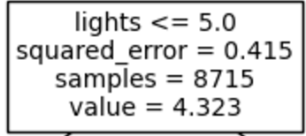
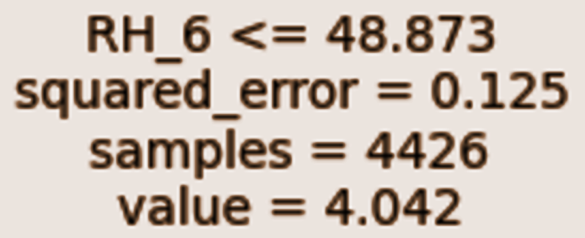
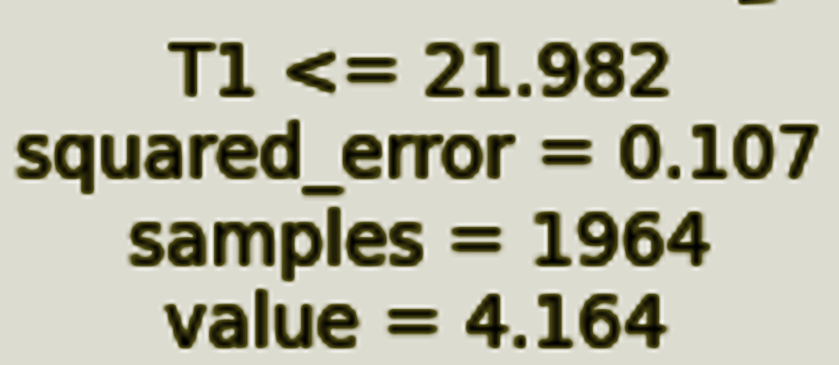
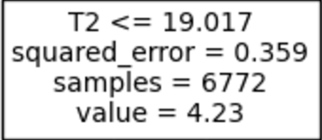
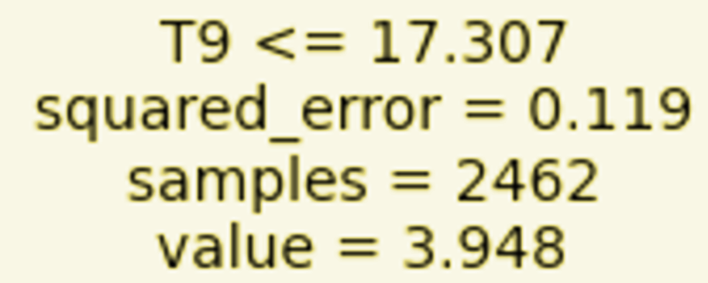
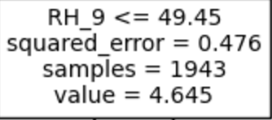
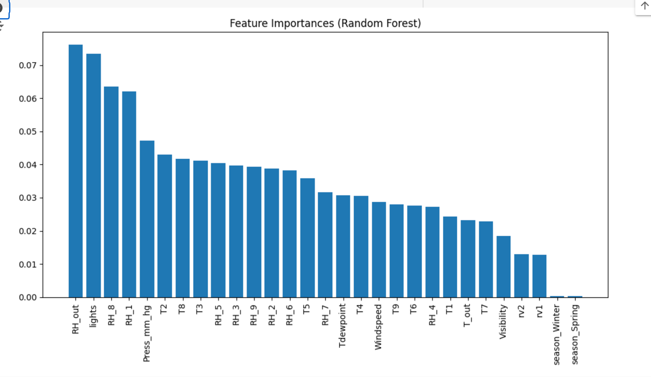
Random Forest
max_features="sqrt", n_estimators=100, max_depth=5:
True
False
Tr MSE: 0.2991
Te MSE: 0.3378
Tr R²: 0.2852
Te R²: 0.2549
By GridSearchCV, the best parameters are: {'max_depth': None, 'min_samples_leaf': 1, 'min_samples_split': 2, 'n_estimators': 200}
Random Forest feature importance:
RH_out: Humidity outside (from Chievres weather station)
lights: energy use of light fixtures in the house
RH_8: Humidity in teenager room 2
Tr MSE: 0.01828
Te MSE: 0.1406
Tr R²: 0.95632
Te R²: 0.6900

Slide 13
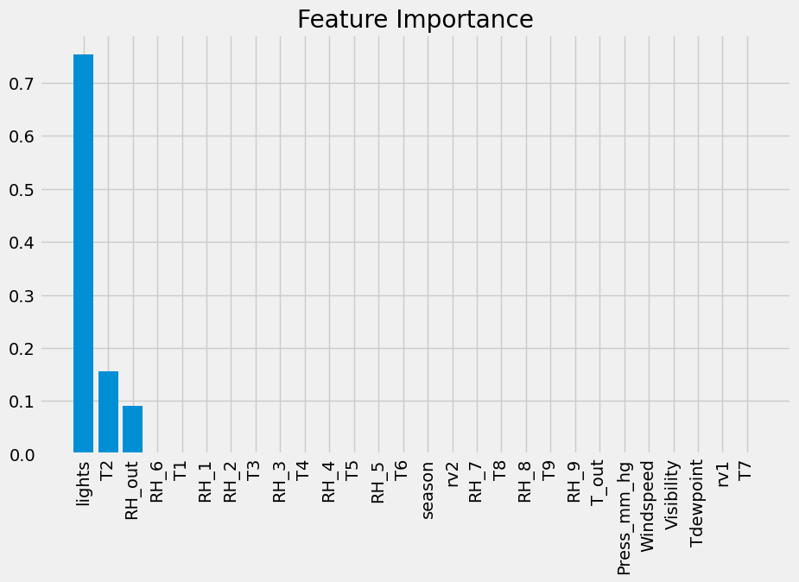
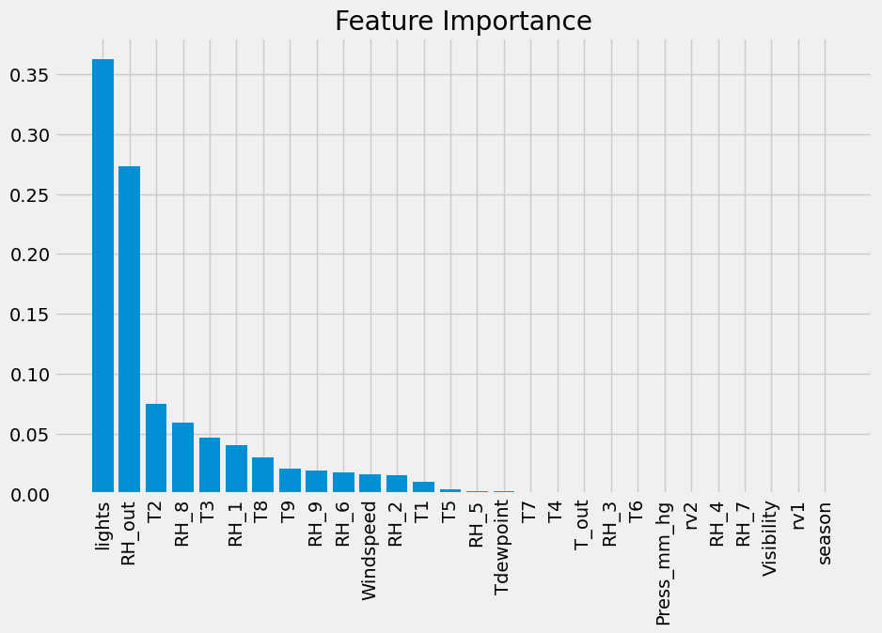
Boosting
By using AdaBoostRegressor, the best parameters are:
{'estimator__max_depth': 3, 'learning_rate': 0.01, 'n_estimators': 100}
Max_ depths=3
When n_estimators=100, learning_rate=0.01
Max_depth = 1
Tr MSE: 0.38820
Te MSE: 0.41968
Tr MSE: 0.33573
Te MSE: 0.36849
Tr R²: 0.07244
Te R²: 0.07432
Tr R²: 0.19780
Te R²: 0.18723
Notes:
AdaBoost assigns weights to training samples, iteratively focusing on samples that were poorly predicted by previous weak learners
Max_depth =1
AdaBoost repeatedly select lights as the most dominant feature as it consistently provides the best splits and captures the most variance or error reduction during boosting
Max_ depths=3
max_depth = 3: lights is less the sole dominant predictor, and other features such as RH_out, T2, and RH_8 contribute significantly to the model. Increasing the tree depth & # of estimators captures more complex patterns and interactions in the data, leading to a more nuanced distribution of feature importance compared to shallow trees with max_depth=1

Slide 14


Comparing model accuracy
 | Baseline (ȳ) | LR | Lasso | Ridge | KNN | Decision Trees | Random Forest | Boosting
MSE train | 0.418 | 0.31 | 0.305 | 0.305 | 0.328 | 0.112 | 0.018 | 0.336
MSE test | 0.453 | 0.33 | 0.330 | 0.330 | 0.365 | 0.255 | 0.141 | 0.368
Future Scope
Granularize further (instead of diving by season, divide by day of the week)
Work with a longer time frame (>4.5 months)
Try these models and compare effectiveness amongst different buildings in different locations
Notes:
Dataset doesn’t have high generalizability because of 1 building, different for every building

